Slide 1
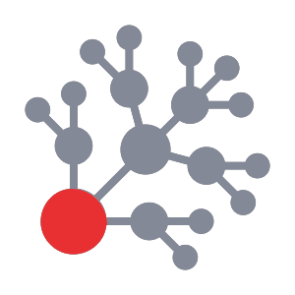
TruthChain
Team: USTLab
Aims to eliminate fake information in the digital world.

Slide 2
Exhibit title
Title
Title
Text
Text
Text
Text
Text
Text

Slide 3

Name: Narendranath Reddy Thota
Trainer from Gamma
Blockchain Full Stack Developer
Technology Analyst
Software Developer
Technology Speaker
UID: U54886, MAERSK
Email: narendranath.thota@ust-global.com
https://www.developerweekend.org/

Slide 4
Use cases - TruthChain
1) News(articles) on Blockchain
- Eliminate Fake News to prevent from False News.
2) Original Product details on Blockchain
- Eliminate Fake Products to prevent buyers from Fake Products.
3) Medicine details on Blockchain
- Eliminate Fake Medicine to save patients.
4) Provider(Doctor) details on Blockchain
- Eliminate Fake Doctor Details to save patients.
5) medical bill & reports to Payers with Blockchain
-To Eliminate Fake Reports by Fake People
6) License details on Blockchain
-To Eliminate Fake license in Digital world
7) Form-16 details on Blockchain
- To Make Tax Filing more Efficient with Blockchain
Many more use cases with TruthChain.

Slide 5
Use Case Of TruthChain
Practical
To Eliminate Fake News(articles)

Slide 6
Why fake news is bad
Fake news is an issue that affects all of us, especially considering its ability to swing public opinion and even spark violence, as occurred in Washington, DC where a man discharged a rifle in a pizza restaurant after reading a completely fabricated story that the restaurant was the center of a Hillary Clinton-affiliated child pornography ring. Luckily, no one was hurt, but it could have been tragic.

Slide 7
Abstract
A decentralized news network backed by incentives for individuals to create, review, and consume news. The primary innovation of blockchains is a verifiable and cryptographically secured global ledger that can lead to new types of incentive structures. Developers can take advantage of the Ethereum blockchain to build applications that are not only architecturally and politically decentralized, We propose a network in which writers produce news content that is reviewed by fact-checkers(Reviewers) before being published on the network without the risk of being taken down. We label the news item as fake or true and then store them in a decentralized, unalterable system not governed or controlled by any person or group and hence the voted and accepted truth cannot be altered by currently powerful people who have been running their empires by manipulating people and conveying altered information and misrepresented facts to them. Print media and multimedia to maintain employees for genuine information is very costly, very difficult and easily manipulate, if media wants to check a particular information is genuine or fake or to get latest news then they can check thorough TruthChain with less cost. Finally, social media, print media Health care, Finance, Banking and multimedia etc. will deliver original news to all over the world through TruthChain with less cost. TruthChain is a collection of genuine news/information and a platform to eliminate all fake news in the digital world.

Slide 8
PROBLEM Statement
Fake news websites (also referred to as hoax news websites) are Internet websites that deliberately publish fake news—hoaxes, propaganda, and misinformation purporting to be real news—often using social media to drive web traffic and amplify their effect. Unlike news satire, fake news websites deliberately seek to be perceived as legitimate and taken at face value, often for financial or political gain. Such sites have promoted political falsehoods. In most news sites, the community tends to hang at the bottom of articles in comments that serve little purpose.

Slide 9
Background
In 1983, 90 percent of the U.S. news industry was owned and controlled by 50 different companies. Thirty-four years later, 90 percent of American news coverage, whether read, watched or listened to, flows from just six media conglomerates: Comcast Corporation; News Corporation; The Walt Disney Company; Viacom Inc.; Time Warner Inc.; and CBS Corporation.
SOCIALMEDIA:
Over the past decade, there’s been a big shift in the way people stay informed. Indians looked to daily newspapers and television for much of their news; however, this behavior has significantly shifted elsewhere. 62 percent of adults rely on social media for news.
Among social media providers, Facebook has become a rival to the big suit and- tie networks like CNN, Fox News, ABC, and NBC. Facebook has become a gatekeeper for much of the news that Americans consume online.

Slide 10
FACEBOOK ALGORITHM:
The order and visibility of posts in Facebook’s news feed is governed by a sophisticated proprietary algorithm, which has the ability to decide which posts to showcase over others. This amounts to the power to manipulate which posts consumers see.
The platform tries to choose posts that people are likely to read, like, and share with friends. Facebook hopes this will induce people to return to the site.
This has the dangerous effect of turning the platform’s feed into a tabloid that sucks users in and gives them a place to continue reading the same type of content.
There are a large number of websites whose sole purpose is to drive the spread of flimsy and groundless stories. For them, integrity is derived primarily from click-rates and impressions, rather than factual reporting, as reported by The New York Times just after the 2016 presidential election.

Slide 11
TruthChain:
TruthChain is a news platform that combines news creation with decentralized networks as a means to delivering factual content, curated by a community of readers, writers, and reviewers.
TruthChain will harness the power of the Ethereum blockchain to create an infrastructure that is virtually impossible to infiltrate or take down. Since TruthChain is not centralized, it does not suffer from having a single point of failure.
The platform’s core purpose is to present news as accurately as or hidden agendas, which plague most news corporations. The TruthChain platform will focus on facilitating the dissemination of balanced and factual observation of current newsworthy affairs.
TruthChain mission is to create news content that is both empowering for its readers, as well as representative of the integrity of its writers. TruthChain aspires to become the most trusted and democratic news alternative to the mainstream media.

Slide 12
WHY IS TruthChain NECESSARY?
The idea is that if news distribution were to function without any central authority, less importance would reside on media titans and there would exist a higher degree of autonomy and independence from the bottom-up, starting with journalists and ending at readers.
Distributors of news can act as nimble vessels for disseminating accurate information without any overseers but the community they serve, leading to greater integrity and a fearlessness to report. At the end of the cycle, readers can focus on the content — the news —free of corporate influence and more transparent because of the power and function of blockchain technology.
Transparency in news can make way for a more democratic and freer thinking press. In addition, suppression of information and mass censorship by governments and corporations, is a threat to publishers and writers throughout the world.
A gag order is a common tool used by governments to restrict publishers from disclosing certain details, regardless of how factual those details may be. The people have a right to the facts and the truth. The core purpose of TruthChain is to provide truly factual news that is curated and community-moderated.

Slide 13
Overview of key actors on the network:
WRITERS:
Writers, or reporters, are individuals who submit news content in the form of articles. Whether freelance journalist, casual blogger, or an average consumer of global news, anyone can contribute to the TruthChain.
REVIEWERS:
Reviewers, or editors, read and vote upon submitted articles before an article is available for public consumption on the TruthChain article feed. The review process includes basic tasks such as noting grammatical errors, pointing out inaccuracies and questionable statements, as well as content classification.
Most important, however, is that reviewers ensure articles adhere to the TruthChain content guidelines. Reviewers do not have the ability to modify articles, but rather can accept or reject
READERS:
Unlike readers on traditional news platforms, readers on TruthChain play an active role in helping to shape the news they read, which includes participating in Reader Suggestions whereby article topics are put forward by you, the news consumer.

Slide 14

Article Stages

Slide 15
OVERVIEW OF TruthChain:

Slide 16
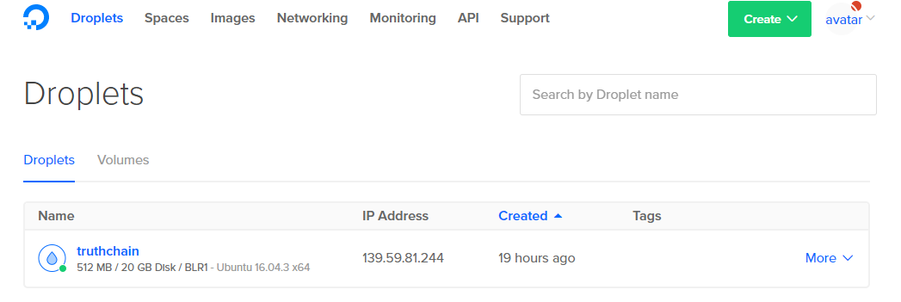
ACCESSING TruthChain:
Signup Access code: 11421
Cloud server with Nodejs,
Mongodb, Blockchain and
Truthchain webapp deployed
Step1:
http://truthchain.tk/
I here by uploaded the code to d3 hackathon website, please download and setup in your local system. Please follow instructions to setup in your local system.
Step2:

Slide 17
Steps to setup local – TruthChain webapp
First install Nodejs: https://nodejs.org/en/ Download 8.8.1 current version.
Install testRPC (In Memory Blockchain)
command for that is : “npm install –g ethereumjs-testrpc"
Install mongodb 3.4 version its free
Enterprise Server: https://www.mongodb.com/download-center#enterprise.
Download truthchain code and give command: “npm install”
Finall command is “node server”
Webapp will live at 7085 port access it through http://localhost:7085
Note: Auto fetch is different to TruthChain webapp
Writer job is Automated by AI - NLP(python) - Auto fetch

Slide 18




Technology Architecture - TruthChain Webapp
UI
CSS
Bootstrap
Html
Handlebars JS
Node.js
All required software's
Deployed into
Cloud – Digital Ocean
Web3JS
Proxy
Block1
Block2
Block3
Block4
Block5
BlockN
Blockchain
Notes:
Who is going to be the target market - customer demographics, purchasing habits, buying cycles, and willingness to adopt the solution? Is there a viable market? How will the product make money? What is your competitive readiness to realize unmet customer needs.

Slide 19





Technology Stack
JavaScript
Html, CSS
Bootstrap
Web3js
REST
Websockets- Socket.io
CK Editor
Solidity Language-(contracts)
Ethereum (testRPC)
Express Framework
Express Sessions
Notes:
Who is going to be the target market - customer demographics, purchasing habits, buying cycles, and willingness to adopt the solution? Is there a viable market? How will the product make money? What is your competitive readiness to realize unmet customer needs.

Slide 20
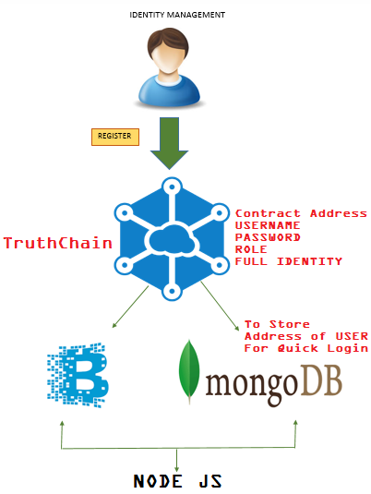
Architecture: IDM
Status: Completed, Working

Slide 21
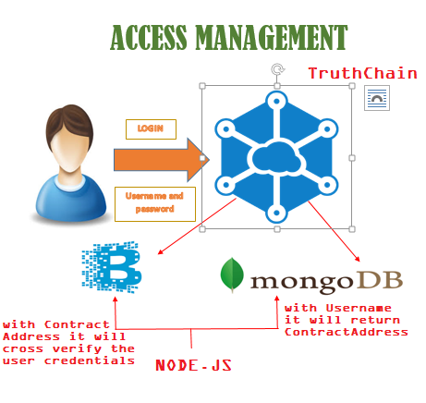
Architecture: IAM
Status: Completed, Working

Slide 22
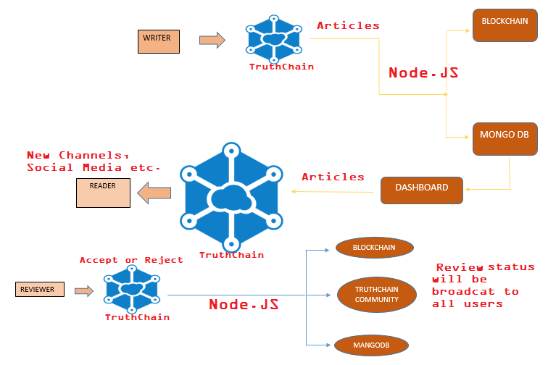
Full Architecture:
Status: Completed, Working

Slide 23
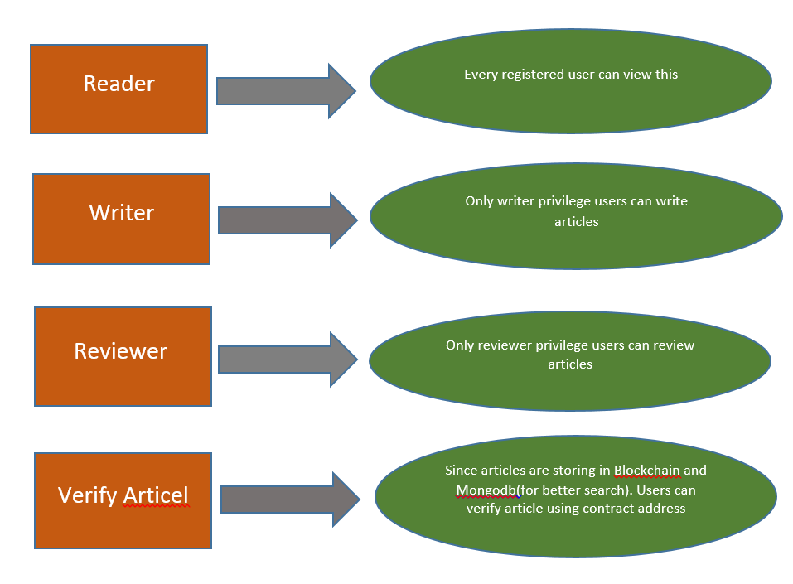
Roles - Architecture:
Status: Completed, Working

Slide 24
Important Note:
Two Approaches for Articles:
First approach: Writer will write Articles based on Reader suggestion or current News or Interesting news etc.
Second approach: Auto fetch Articles from different websites through Natural Language Processing(NLP) – python, user need to give URL’s of news feeds, Algorithm automatically will fetch articles from websites and it will store in MongodB and Blockchain.
Note:
First approach is integrated in TruthChain webapp, storing to MongodB, blockchain and retrieving all operations are working as expected.
Second approach – fetching articles from websites and storing to MongodB is completed and storing to blockchain with python is In Progress.

Slide 25
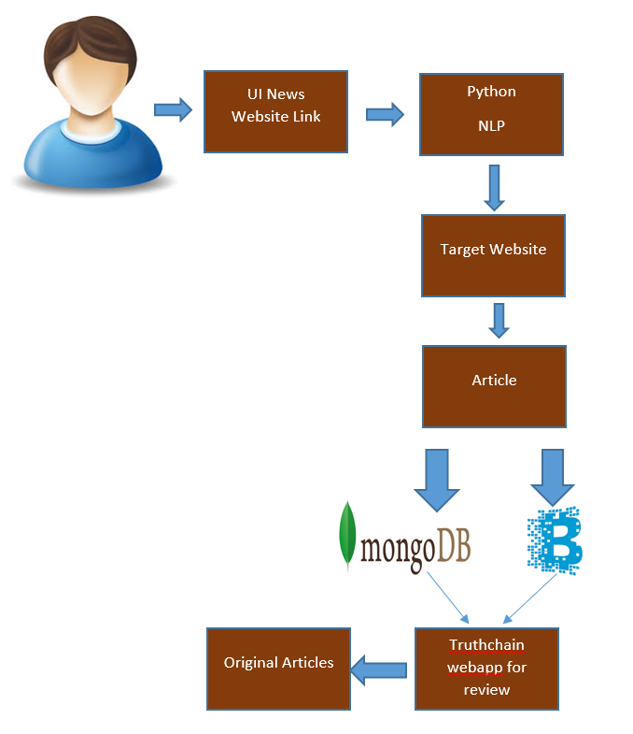
Auto Fetch Articles from Different Websites Python - NLP
Status: Auto fetch through python is under development:
Auto Fetch and storing Articles in Mongodb – completed
Storing to blockchain in python environment - In Progress

Slide 26
About Auto Fetch
(one should have python 3 and 2 installed in the system for running the code)
LIBRARIES NEEDED:
bottle
os
sys
pymongo
newspaper
nltk
*Use pip install <library name> to install the library.

Slide 27
Explanation:
The whole process happens through the following steps-
1. The URL is taken from the user through a website. To access the website on localhost after running the code go to http://0.0.0.0:8080/truthchain .
2. The URL is then used to build a "newspaper" using the newspaper library.
3. Articles are extracted from the news paper and summary statements are built.
4. The summary statements are then stored in a mongodb database.

Slide 28
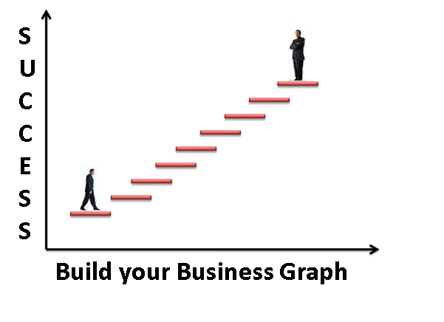
Vision and Roadmap
IFPS
consortium
Blockchain
AI
Chabot's
Notes:
Who is providing the competitive products? How is your product uniquely positioned compared to competition?

Slide 29
Competition
Who else has a similar product?
Innovative Idea
Competitors: No Competitors
Notes:
Who is providing the competitive products? How is your product uniquely positioned compared to competition?

Slide 30
GTM Strategy
TAM
Target is
Public
Sector
Customer Segments
IT Industry, Health Care, Banking, Finance, Social Media, Multimedia etc..
Product
TruthChain
Pricing
Depends on the Market
Profits
Service Charges
For
TruthChain Eco system
Product Packaging
Source files
Notes:
Total addressable market (TAM) – How much is the annual revenue if you are the only provider for the solution?
Customer segment – How can you segment the customers into different groups based on common buying characteristics, needs etc.
Product – your solution.
Pricing – What is the mode / unit of pricing – is it based on perpetual model, subscription based (annual/monthly, per user, per transaction, API usage)
Sales channels – How will you sell your product - Direct sales or partner or reseller / VAR or OEM etc.
Product packaging – Different flavors of the product for different segments? Versions – basic/advanced. Is it bundled with another product?

Slide 31
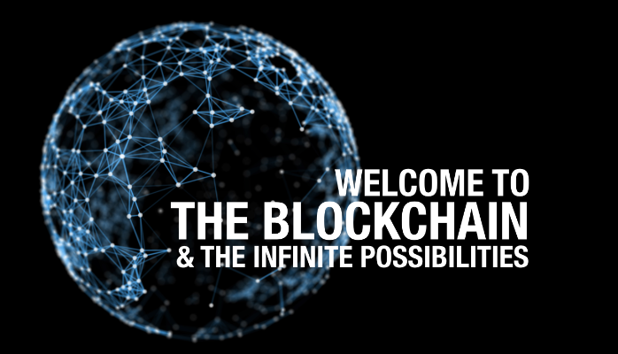
Thank you.

